Slide 1

Human Posture Detection Using MediaPipe and OpenCV
SEMESTER PROJECT CV
https://github.com/MehvishKiani/Human-Posture-Detection-using-MediaPipe-OpenCV

Slide 2
Contents
01
02
03
Abstract
Application of Human Posture Classificaion
Introduction
04
05
06
Methodology
Real Time Implementation
LandMark Overview

Slide 3
Abstract
Tackled the challenge of real-time human posture classification using webcam video.
Used MediaPipe Pose and OpenCV to extract landmarks and classify posture.
Implemented logic for standing, sitting, and lying down detection.
Achieved lightweight, real-time detection with good accuracy and responsiveness.

Slide 4
Applications of This System
Monitor elderly
posture/fall detection
Posture correction in physiotherapy
Detect lying or unusual postures in public areas
Smart Surveillance
Healthcare
Fitness
Real-time feedback during workouts

Slide 5
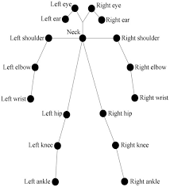
Introduction
Problem Statement
Manual posture assessment is time-consuming and not scalable.
Objective
Develop an automated system to detect human postures using vision-based techniques.
Application
Posture detection is crucial in CV applications like health monitoring, sports, and workplace ergonomics.

Slide 6
Methodology
Model/Logic
Dataset
Rule-based classification using vertical distances between landmarks.
Categories: Standing, Sitting, Lying.
Real-time data captured from webcam using MediaPipe Pose.
33 landmarks extracted (shoulder, hip, knee used for classification).

Slide 7
Methodology
Workflow Diagram
Preprocessing
Normalized coordinates.
Filtered unstable frames using confidence thresholds.

Slide 8
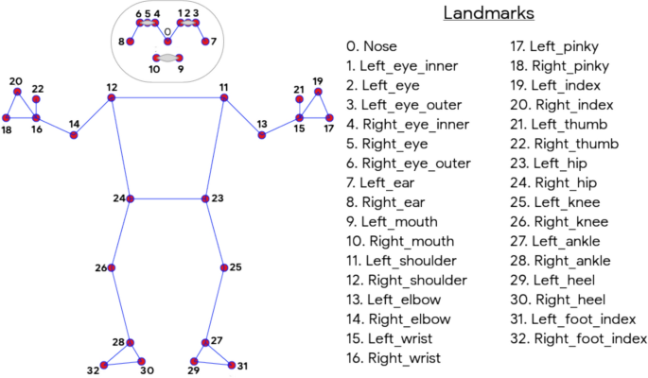
Landmark System Overview
MediaPipe provides 33 key body landmarks
Used landmarks:
Shoulders (11, 12), Hips (23, 24),
Knees (25, 26), Ankles (27, 28)
Nose (0)
X and Y coordinates are
normalized (range 0 to 1)
Posture detection relies on
vertical alignment of landmarks

Slide 9
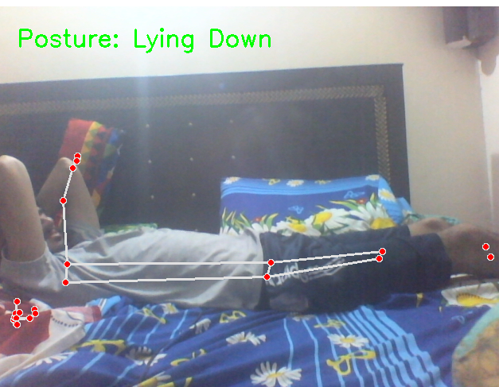
Real-time Implementation
Runs on webcam input (30 FPS)
Uses:
MediaPipe for pose detection
OpenCV for video rendering
NumPy for angle & position calculations
No heavy training required → Runs on most systems

Slide 10
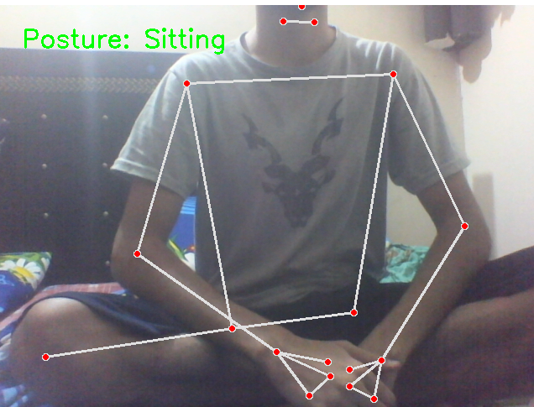
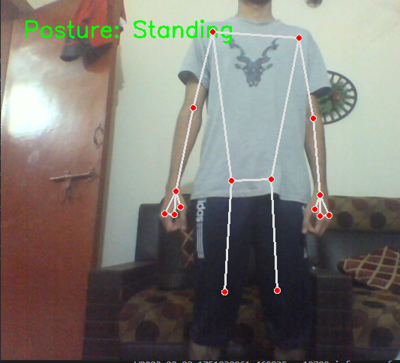

Slide 11
Challenges Faced
Key Challenges
Hard to classify
Accuracy drops in:
Low lighting
Occlusion (e.g., sitting behind desk)
Transition postures (e.g., in-between sitting and standing

Slide 12
THE END
Name: XXX

